Slide 1
Fiduciary Income Tax Planning Tips
Mary Parente, CPA, CGMA
Partner
Trust and Estate
mparente@odpkf.com
May 16, 2014
Notes:
Describe our combination and the benefits

Slide 2
Topics We’ll Cover
Current Tax Schematic
Allowable Expenses
Deferring Income/Accelerating Deductions
Choice of Fiscal Year
IRC Section 645 election
65 Day Election
Final Year
Basis of Assets Transferred/Sold
Estate Tax Deduction (IRD)
DRD – Double Deduction
New on the Horizon

Slide 3
General Rules
Filing a Return
Required if Gross Income > $600
Basics of Form 1041 Taxation
Gross Income $ xx,xxxx
Less: Deductions ( xx,xxx)
Less: Distribution Deduction ( xx,xxx)
Less: Estate Tax Deduction ( xx,xxx)
Less: Exemption ( xxx)
Equals Taxable Income $ xx,xxx
TAX XXX

Slide 4
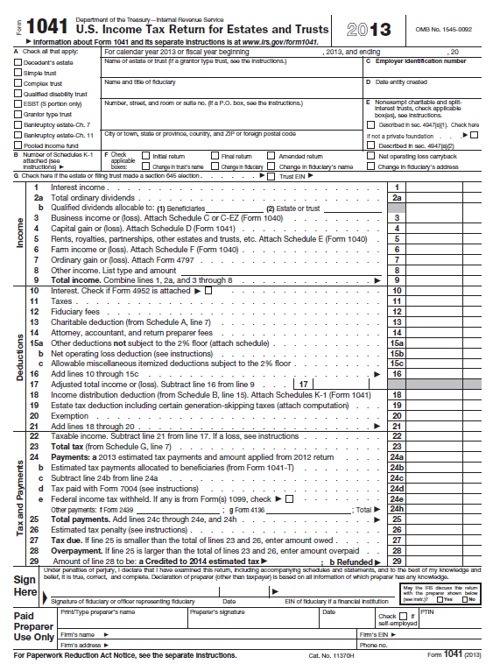
Form 1041, Page 1

Slide 5
General Rules
Distribution Deduction
Function of Distributable Net Income
Equals Taxable Income Reported by Beneficiaries via K-1
Triggered by distribution from Estate
Distributable Net Income
Term of Art
Yardstick - limits the distribution deduction and the amount and character of income attributable to residuary beneficiaries

Slide 6
Estate and Trust Income Tax Rates (2014)
Taxable Income Income Tax Rate L/T Capital Gain Rate
Under $2,500 15% 0
2,500 - 5,800 25% 15%
5,800 – 8,900 28% 15%
8900 – 12,150 33% 15%
Over 12,150 39.6% (+3.8% Surtax) 20% (+ 3.8% Surtax)

Slide 7
Imposition of 3.8% NII Tax for Estates
Lower of:
Undistributed net investment income (NII), or
AGI in excess of $ 12,150
NII (net investment income) includes:
capital gains, interest, dividends, passive income
NII excludes:
Qualified retirement income (IRA, 401K, etc.)
Active business income
Compare to 3.8% for Individuals
Single Taxpayer – AGI exceeds $ 200,000
Married Filing Joint Return – AGI exceeds $250,000

Slide 8
General Rules of Estate Income Taxation
Income
Rules same as individual for reporting interest, dividends, tax exempt income, capital gains, rents, partnership K-1
Deductions
Estates entitled to many of same deduction as individuals
Allocation to tax exempt income
Direct vs. indirect methodology
Exemption – $ 600

Slide 9
Types of Deductions
Interest
Same as individual
Personal interest not deductible
Qualified Residence interest is deductible
Interest arising from tax deficiencies not deductible
Investment Interest Expense is deductible
Taxes
State income taxes – with respect to income earned by estate
State Estate, Gift, or Inheritance Tax – not deductible

Slide 10
Types of Deductions
Administration Expense
Fiduciary Fees (line 12)
Attorney and accounting (line 14)
Other deductions not subject to 2% (line 15a)
Costs incurred during administration of estate that would not have been incurred if the property were not held in estate, for example
Probate costs,
Investment fees
Appraisal costs
Subject of substantial controversy

Slide 11
Types of Deductions
FINAL REGS ISSUED 5/9/14
Applies to tax years beginning after issue date
Retains the requirement that certain fees be unbundled
Deductible to the extent it exceeds the fee generally charged to an individual investor, where the excess is attributable to an unusual investment objective of the estate or to the need for a specialized balancing of the interest of various parties such that a reasonable comparison with individual investors would be improper.
Specifically includes appraisal fees and other probate fees as not subject to 2%

Slide 12
Types of Deductions
Deductions Subject to 2%
Deductible to the extent they exceed 2% AGE
Similar to individuals but calculated differently
Interrelated calculation best left to software
Examples:
Investment advisory fees,
Maintenance and preservation expenses

Slide 13
Special Deduction
Income Distribution Deduction
Does not exist in other entities subject to Federal Taxation (except trusts)
Based on the Distributable Net Income of the Estate
Computation on Form 1041, page 2, Schedule B (illustration)
Mechanism to determine income available for distribution
Excludes capital gain
Includes tax exempt income
Source of K-1 to beneficiaries
Usually residuary beneficiaries receive K-1
Beneficiaries who receive specific bequests excluded since they do not share in the income/expense of estate

Slide 14
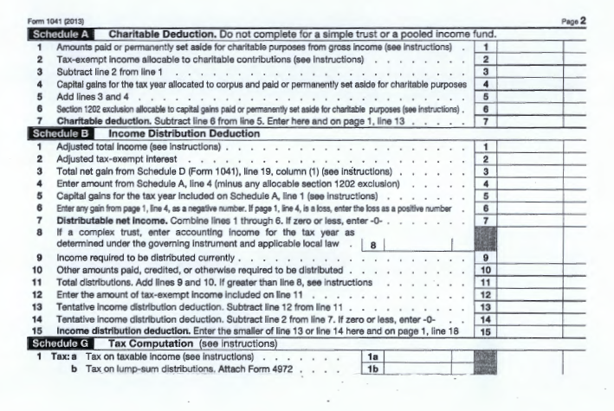
Form 1041, Page 2

Slide 15
Planning Opportunities
Choosing Fiscal Year
Option to report on any month end
Caveat – 1st year cannot be more than 12 months
Used to defer income, e.g.
11/30/13 estate year end - removes 12/31/13 K-1 (from a flow through entity) from estate and defers to 11/30/14 estate income tax return
Fiscal year beginning 2/1/14 ending 1/31/15 defers income (assuming distribution to beneficiary) reporting of beneficiary to 2015
Inclusion of Revocable Trust with Estate Income Tax Return
a.k.a. Section 645 Election
Ability to use fiscal year for trust activity
Reduces administrative burden of filing two income tax returns
Lasts two years beyond decedent’s DOD (longer if filing 706)

Slide 16
Planning Opportunities
65 Day Election
Ability to treat any distribution made within first 65 days of estate tax year as having been made in the prior year
Beneficial to beneficiaries in lower tax brackets than estate (probably every beneficiary)
Checkbox election
Can reduce “surprise” income in the estate
Final Estate Income Tax Return
Defer expenses that exceed income to final year – Why?
Final year excess deductions pass out to beneficiaries
Capital losses and NOL’s also pass out to beneficiaries
Suspended PAL’s (if any) increase basis of assets distributed to beneficiaries

Slide 17
Planning Opportunities
Basis of Assets
Stepped up on Date of Death (or Alternate Valuation Date)
Rarely results in significant gain – ask the question if not the case
Exception – 2010 estate electing modified carryover and holding period
Long-Term Gain treatment regardless of when purchased by decedent
Communication with broker a must to correct basis on all assets sold or eventually distributed to beneficiaries!!!!!!
Sale of personal residence – capital loss treatment

Slide 18
Planning Opportunities
Estate Tax Deduction for (IRD)
a.k.a 691( c ) deduction or the double tax
Less frequent application due to increased estate exemption amount
Applies to assets that do not receive a step up at death (or IRD assets) included in estate return and taxable when received by the estate (or directly by beneficiary)
Wages of decedent
IRA’s, 401K
Dividends declared prior to death but paid after death
Installment Note
Deduction of estate tax paid against income included on fiduciary or beneficiary’s income tax return.
Must be communicated by estate tax preparer to professionals preparing the fiduciary income tax return and the beneficiary income tax return.

Slide 19
Planning Opportunities
DRD (Deduction in Respect of Decedent)
Double Deduction Benefit (Form 706 and Form 1041)
Must be a liability at decedent’s DOD
Can be determinable with certainty and will be paid
Decedent was liable
Examples:
Business Expenses
Interest Expense
Taxes – Income and Real Estate
Investment Expenses
% Depletion

Slide 20
Planning Opportunities
Estimated Taxes
Estimated taxes not required until two years after estate commences (2015 for an estate beginning in 2013)
In final year of estate, 1041-T to allocate to beneficiaries (must be filed within 65 days of year-end); otherwise will need to file for refund.

Slide 21
Planning Opportunities
Allocation of Administration Expenses to form 706 vs. Form 1041
Strategy
Allocate expense to return with higher marginal tax rate
Prior to 2013 Beyond 2013
Estate Tax 45% 40%
Income Tax 35% 39.6% + 3.8%
Result: More Difficult Now

Slide 22
Questions
Is marital/charitable deduction reduced?
Will it cause a taxable estate?
Is Net Investment Income Tax applicable?
Are administration expenses subject to 2%?
Sufficient income to benefit from deduction?
Is there a state income tax?
Is there a state death tax ?
Amount of exempt income?
See comparison chart

Slide 23
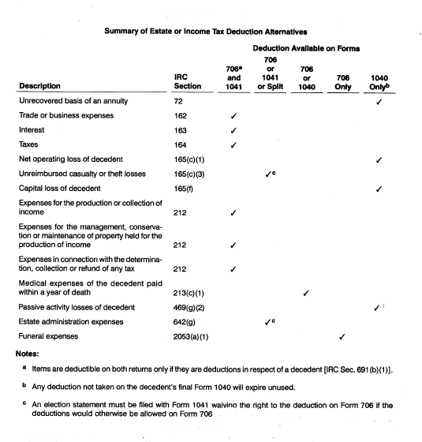
Comparison Chart

Slide 24
Distributions in Kind
General rule – no gain or loss recognition – carryover basis to beneficiary
Special Election [643 ( e) election] to treat distributed property as sold at FMV on date of distribution and recognize gain at estate level.
Will apply to all assets distributed during that year
Loss recognition not allowed since transaction is treated as a sale to a related party and not recognized.
Exception – loss on funding a pecuniary bequest can be recognized.
Used when estate has large capital losses or other losses which will not be used.
Shouldn’t be used if beneficiary in lower tax bracket, asset will be held by beneficiary for a long period, or will be held by beneficiary until death.

Slide 25
Thank You
Questions?

